Slide 1



GROUP 8 HEALTHCARE CAPSTONE PROJECT
View in Power BI
Last data refresh:
24/01/2026 11:10:39 UTC
Downloaded at:
24/01/2026 11:45:34 UTC

Slide 2
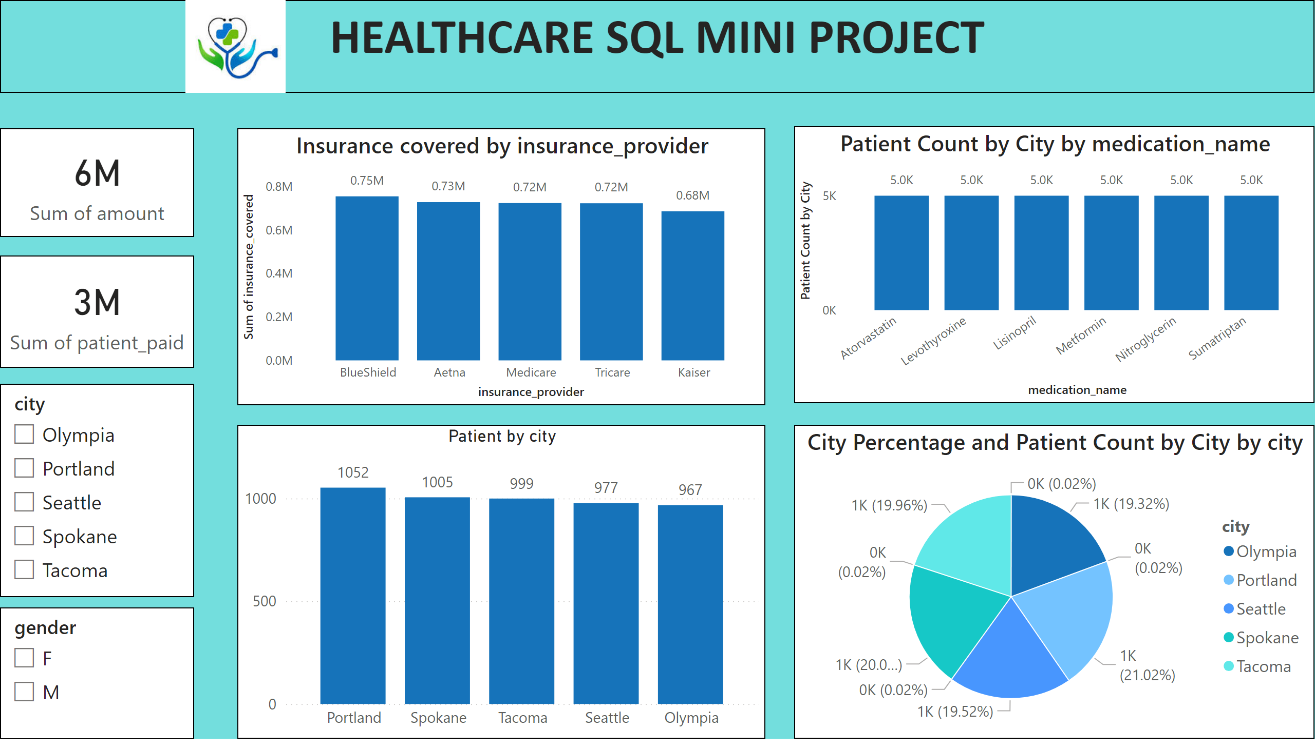
Patient Demographics
Notes:
slicer
No alt text provided
slicer
No alt text provided
card
No alt text provided
card
No alt text provided
Patient by city
No alt text provided
pieChart
No alt text provided
textbox
No alt text provided
lineStackedColumnComboChart
No alt text provided
Insurance covered by insurance_provider
No alt text provided
image
No alt text provided

Slide 3
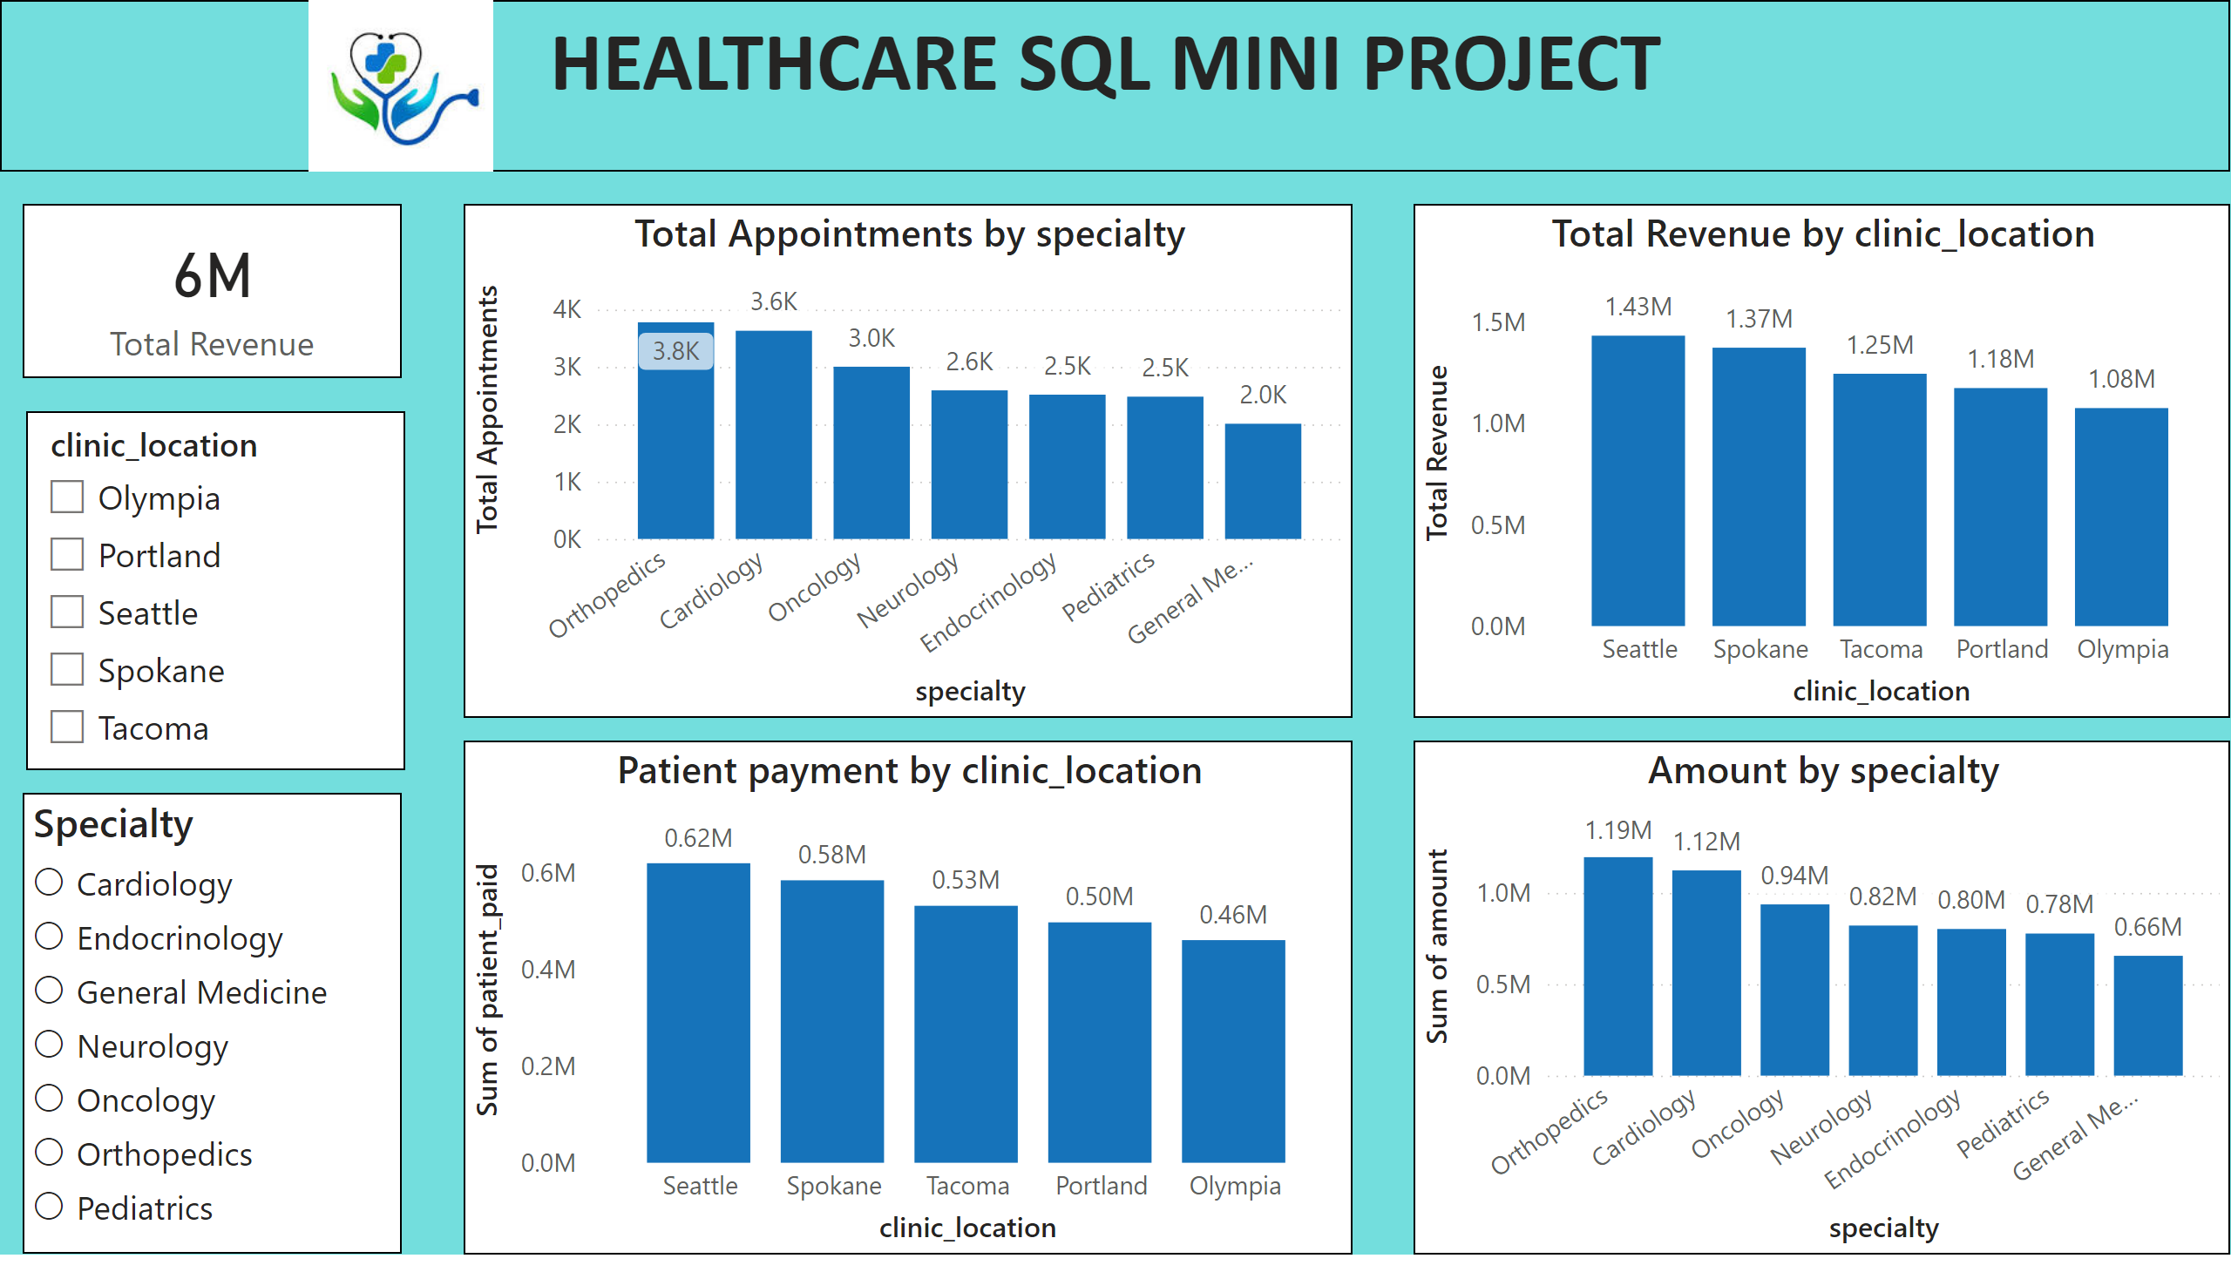
Doctor Performance
Notes:
Clinic Location
No alt text provided
card
No alt text provided
Specialty
No alt text provided
textbox
No alt text provided
lineStackedColumnComboChart
No alt text provided
Amount by specialty
No alt text provided
Patient payment by clinic_location
No alt text provided
lineStackedColumnComboChart
No alt text provided
image
No alt text provided

Slide 4
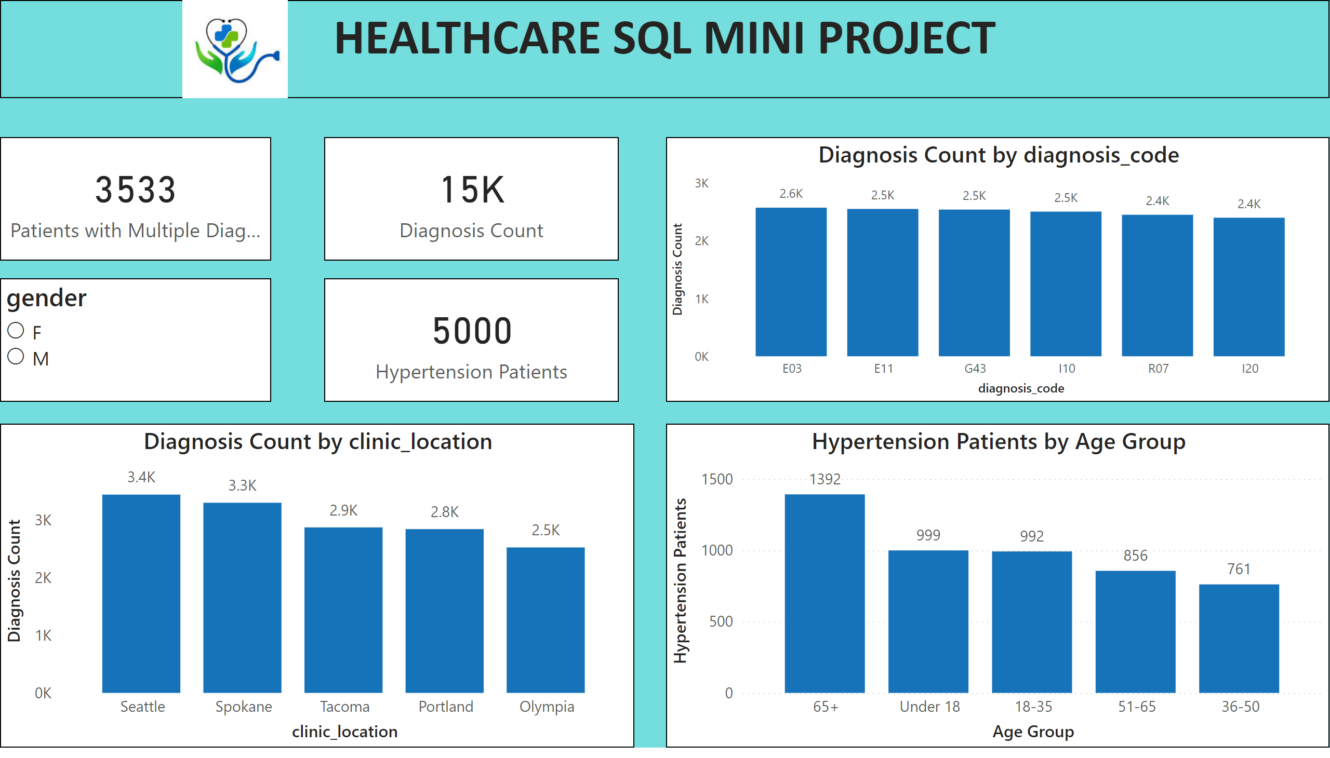
Diagnosis Analysis
Notes:
lineStackedColumnComboChart
No alt text provided
card
No alt text provided
card
No alt text provided
card
No alt text provided
listSlicer
No alt text provided
columnChart
No alt text provided
textbox
No alt text provided
clusteredColumnChart
No alt text provided
image
No alt text provided

Slide 5
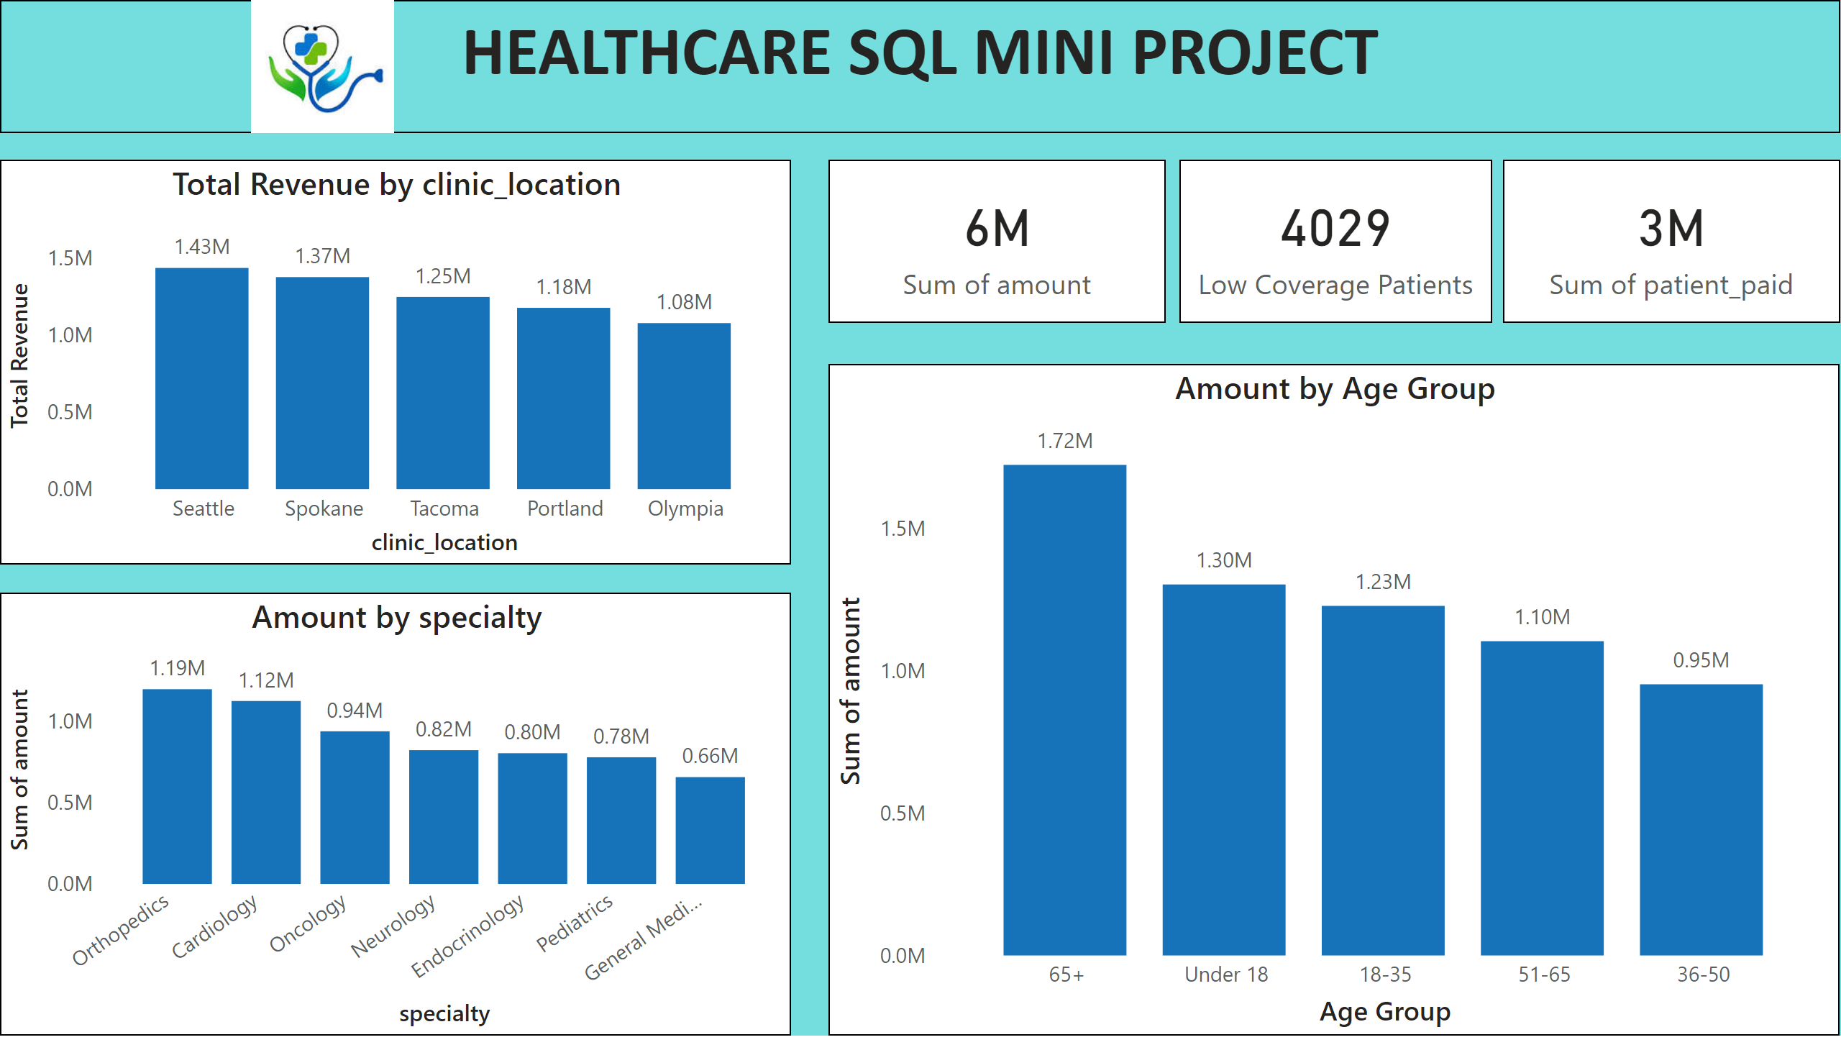
Financial Summary
Notes:
card
No alt text provided
card
No alt text provided
card
No alt text provided
Amount by specialty
No alt text provided
clusteredColumnChart
No alt text provided
textbox
No alt text provided
Amount by Age Group
No alt text provided
image
No alt text provided

Slide 6
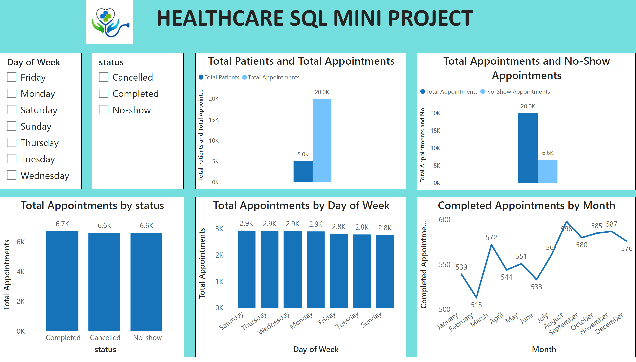
Appointment Trend
Notes:
lineChart
No alt text provided
columnChart
No alt text provided
textbox
No alt text provided
clusteredColumnChart
No alt text provided
clusteredColumnChart
No alt text provided
clusteredColumnChart
No alt text provided
slicer
No alt text provided
slicer
No alt text provided
image
No alt text provided

Slide 7
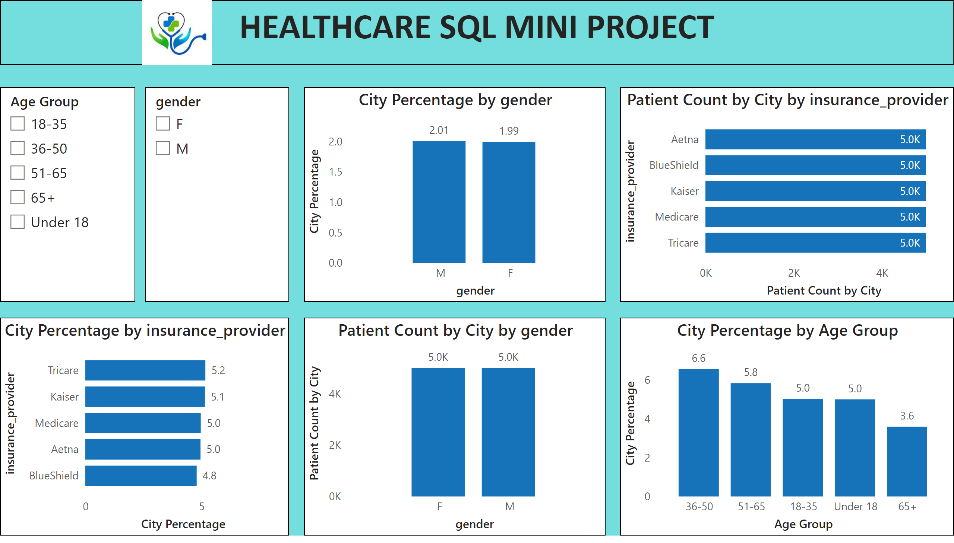
Patient Health Profile
Notes:
clusteredColumnChart
No alt text provided
clusteredColumnChart
No alt text provided
clusteredBarChart
No alt text provided
clusteredBarChart
No alt text provided
slicer
No alt text provided
textbox
No alt text provided
slicer
No alt text provided
image
No alt text provided
clusteredColumnChart
No alt text provided

